Slide 1

Software Project Management 6th Edition
Chapter 6
Activity planning
Notes:
This talk provides an overview of the basic steps needed to produce a project plan. The framework provided should allow students to identify where some of the particular issues discussed in other chapters are applied to the planning process. As the focus is on project planning, techniques to do with project control are not explicitly described. However, in practice, one element of project planning will be to decide what project control procedures need to be in place.

Slide 2
Objectives
Project and Activities
Sequencings and Scheduling Activities,
Network Planning Models, Formulation of Network Model
Adding the Time Dimensions,
The Forward Pass, The Backward Pass,
Identifying Critical Path, Identifying Critical Activities
AOA, GanttChart,
(Installation & Configuration of Software Tools like MS-Project)

Slide 3
Introduction
A detailed plan, however, must also include a schedule indicating the start and completion times both for project as a whole and for individual activities.

Slide 4
Introduction
A detailed project plan will enable us to
Ensure availability of resources when required.
Produce a detailed schedule showing which staff carry out each activity.
Avoid different activities competing for the same resources at the same time.
Produce a detailed plan against which actual achievement may be measured.

Slide 5
Scheduling
‘Time is nature’s way of stopping everything happening at once’
Having
worked out a method of doing the project
identified the tasks to be carried
assessed the time needed to do each task
need to allocate dates/times for the start and end of each activity
Notes:
Suggests that time acts as a mechanism to organize and sequence events in the universe. Without time, all events would occur simultaneously, leading to chaos and confusion. By introducing the concept of time, nature allows for a structured progression of events, enabling life and experiences to unfold in a manageable and understandable way.

Slide 6
Importance of Project Schedules
Managers often cite delivering projects on time as one of their biggest challenges
Time has the least amount of flexibility; it passes no matter what happens on a project
Schedule issues are the main reason for conflicts on projects, especially during the second half of projects

Slide 7
Project Time Management Processes
Planning schedule management: determining the policies, procedures, and documentation that will be used for planning, executing, and controlling the project schedule
Defining activities: identifying the specific activities that the project team members and stakeholders must perform to produce the project deliverables
Sequencing activities: identifying and documenting the relationships between project activities
Estimating activity resources: estimating how many resources a project team should use to perform project activities
Estimating activity durations: estimating the number of work periods that are needed to complete individual activities
Developing the schedule: analyzing activity sequences, activity resource estimates, and activity duration estimates to create the project schedule
Controlling the schedule: controlling and managing changes to the project schedule

Slide 8
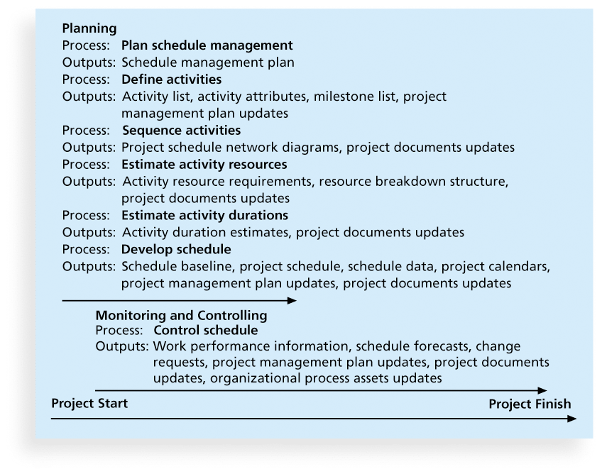
Figure 6-1. Project Time Management Summary

Slide 9
Planning Schedule Management
The project team uses expert judgment, analytical techniques, and meetings to develop the schedule management plan
A schedule management plan includes:
Project schedule model development
The scheduling methodology
Level of accuracy and units of measure
Control thresholds
Rules of performance measurement
Reporting formats
Process descriptions

Slide 10
Objectives of Activity Planning
These help us to:
Assess the feasibility of the planned project completion date
Identify when resources will need to be deployed to activities
Calculate when costs will be incurred
This helps the co-ordination and motivation of the project team
Notes:
Section 6.2 of the textbook discusses this

Slide 11
Defining Activities
An activity or task is an element of work normally found on the work breakdown structure (WBS) that has an expected duration, a cost, and resource requirements
Activity definition involves developing a more detailed WBS and supporting explanations to understand all the work to be done so you can develop realistic cost and duration estimates

Slide 12
Activity Lists and Attributes
An activity list is a tabulation of activities to be included on a project schedule that includes
the activity name
an activity identifier or number
a brief description of the activity
Activity attributes provide more information such as predecessors, successors, logical relationships, leads and lags, resource requirements, constraints, imposed dates, and assumptions related to the activity

Slide 13
Milestones
A milestone is a significant event that normally has no duration
It often takes several activities and a lot of work to complete a milestone
They’re useful tools for setting schedule goals and monitoring progress
Examples include obtaining customer sign-off on key documents or completion of specific products

Slide 14
Projects and Activities A - Defining Activities
A project is composed of a number of interrelated activities.
A project may start when at least one of its activities is ready to start.
A project will be completed when all of its activities have been completed.
An activity must have clearly defined start and end-points.
Resources required by the activity must be forecastable to measure the effort.
The duration of the activity must be forecastable.
Some activities might require that others are completed before they can begin (these are known as precedence requirements)

Slide 15
Sequencing Activities
Involves reviewing activities and determining dependencies
A dependency or relationship is the sequencing of project activities or tasks
You must determine dependencies in order to use critical path analysis

Slide 16
Three types of Dependencies
Mandatory dependencies: inherent in the nature of the work being performed on a project, sometimes referred to as hard logic. For example, you cannot test code until after the code is written.
Discretionary dependencies: defined by the project team., sometimes referred to as soft logic and should be used with care since they may limit later scheduling options. For example, not start the detailed design of a new information system until the users sign off on all of the analysis work.
External dependencies: involve relationships between project and non-project activities. E.g. delivery of new hardware

Slide 17
Projects and Activities B - Identifying Activities
Work-based: draw-up a Work Breakdown Structure listing the work items needed
Product-based approach
list the deliverable and intermediate products of project – product breakdown structure (PBS)
Identify the order in which products have to be created
work out the activities needed to create the products
Hybrid approach: A mix of the activity-based approach and the product-based approach.

Slide 18
Approaches for Identifying Activities
Identifying Activities
Activity Based Approach
Product Based Approach
Hybrid Approach

Slide 19
Activity Based Approach
The activity based approach consists of creating a list of all activities that the project is thought to involve.
This can be done by
Brainstorming session involving the whole project team
The analysis of similar past projects.

Slide 20
Activity Based Approach
When preparing the WBS:
Too great depth should be avoided as it will result in a large number of tasks that will be difficult to manage.
Too shallow structure should be avoided as this will provide insufficient detail for project control.
Each branch should be broken down at least to a level where each leaf may be assigned to an individual or responsible section within the organization.

Slide 21
Activity Based Approach
Advantages of WBS are
More likely to obtain a task catalogue that is complete and composed of non-overlapping activities.
WBS represents a structure that can be refined as the project proceeds. It can start shallow early in the project and can be developed as information becomes available.

Slide 22
Product Based Approach
It consists of producing a product breakdown structure PBS, and a product flow diagram PFD.
Product Breakdown Structure (PBS)
It shows how a system can be broken down into different products.
It is less likely that a product will be left out of a PBS that that an activity might be omitted from an unstructured activity list. Why?

Slide 23
Product Based Approach
Product Flow Diagram (PFD)
It indicates for each product, which other products are required as ‘inputs’.
It is easily transformed into an ordered list of activities by identifying the transformations that turn some products into others.

Slide 24
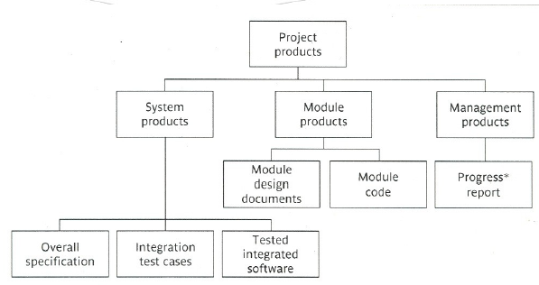
Product Based Approach

Slide 25
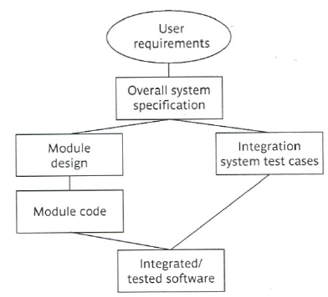
Product Based Approach

Slide 26
Hybrid Approach
It is the most commonly used approach.
A mix of the activity-based approach and the product based approach.
The “WBS” in the hybrid approach is based on:
a list of the final deliverables
a set of activities required to produce each of these deliverables.

Slide 27
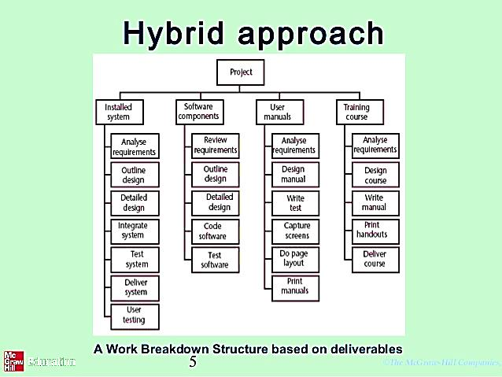
Hybrid Approach

Slide 28
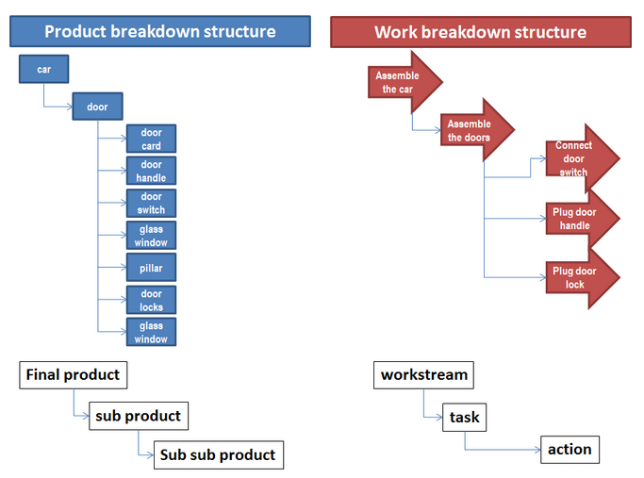
PBS VS WBS
What is that product made up of
How the product will be made
Notes:
WBS : "How the product will be made?“
PBS : "What is that product made up of?“
HYBRID : "What is the product scope and how it will be made?".
Work-Based Approach
In the work-based approach, we focus on the tasks that need to be done to organize the party. For example:
Create a guest list
Send invitations
Order a cake
Decorate the venue
Prepare games and activities
Set up food and drinks
Each of these tasks represents a specific piece of work that needs to be completed to successfully organize the party.
Product-Based Approach
In the product-based approach, we focus on the final outcomes or deliverables of the party. For example:
Guest List: A finalized list of attendees.
Invitations: Physical or digital invitations sent out to guests.
Birthday Cake: A cake ordered and delivered for the party.
Decorations: The decorations set up at the venue (balloons, banners, etc.).
Games and Activities: Prepared games and activities that will take place at the party.
Food and Drinks: A selection of food and drinks available for guests.
Work-Based Approach
In this approach, we list the steps or tasks needed to make a sandwich:
Gather ingredients (bread, cheese, lettuce, etc.)
Spread mayonnaise on the bread
Add cheese and lettuce
Put the second slice of bread on top
Cut the sandwich in half
These are the specific actions you need to take to complete the task of making a sandwich.
Product-Based Approach
In this approach, we focus on the end result, which is the finished sandwich. The activities are identified based on what the final product should look like:
Ingredients: Bread, cheese, lettuce, mayonnaise
Assembly: Combining all ingredients to create the sandwich
Presentation: The way the sandwich is cut and served

Slide 29
Work breakdown structure – An Example

Slide 30
Product based approach - An example

Slide 31
Hybrid approach – An example
A Work Breakdown Structure based on deliverables
Notes:
The IBM MITP (Managing the Implementation of total project) approach suggested the following 5 levels
Level 1: Project
Level 2: Deliverables
Level 3: Components – which are key work items needed to produce the deliverables
Level 4: Work packages: groups of tasks needed to produce the components
Level 5: Tasks

Slide 32
Hybrid Approach (cont’d)
IBM in its MITP methodology suggests 5 levels
Level 1: Project
Level 2: Deliverables (software, manuals etc)
Level 3: Components
Level 4: Work-packages
Level 5: Tasks (individual responsibility)
Notes:
MITP: Managing the Implementation of Total Project
Components: key work items lead to the production of the deliverables
Work-packages: major work items or collection of related tasks to produce a component

Slide 33
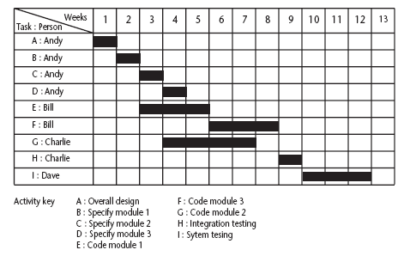
Sequencing and Scheduling Activities Simple Sequencing Technique
One way of presenting a project plan is to use a bar chart
The chart tells us who is doing what and when.
But it does not shows why certain decisions are made.
No logical relations.
Notes:
Once the Project’s activities have been identified (whether or not by using a WBS), they need to be sequenced in the sense of deciding which activities need to be completed before others can start.
The chart tells us who is doing what and when.

Slide 34
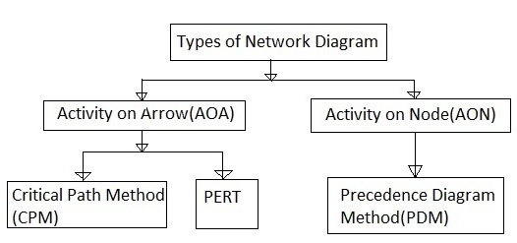
Network Planning Models
The project scheduling techniques model the project’s activities and their relationship as a network.
AOA approach is used to visualize the project as a network where activities are drawn as arrows joining circles, or nodes, which represent the possible start and/or completion of an activity or set of activities.
AON networks, activities are represented as nodes and links between nodes represent precedence (or sequencing) requirements. Majority of the computer applications use this method.

Slide 35
Formulating a Network Model
Constructing precedence Network
A Project network should have only one start node.
A Project network should have only one end node.
A node has a duration
Links normally have no duration, links represents the relationships.
Precedents are the immediate preceding activities.
Time moves from left to right.
A network may not contain loops.
A network should not contain dangles i.e. an activity with no successor.
Representing Lagged Activities
Where activities can start in parallel with a time lag between them, we represent the lag with a duration on the linking arrow.
Hammock / Summary tasks or Activities
These are the activities which, in themselves, have zero duration but are assumed to start with start of first subsequent activity and ends with last.
Notes:
Hammock definition: A bed made of canvas or rope mesh suspended from two supports by cords at both ends. Or hanging between.

Slide 36
Network Diagrams
Network diagrams are the preferred technique for showing activity sequencing
A network diagram is a schematic display of the logical relationships among, or sequencing of, project activities
Two main formats are the arrow and precedence diagramming methods

Slide 37
Lagged activities
Where there is a fixed delay between activities e.g. seven days notice has to be given to users that a new release has been signed off and is to be installed
Acceptance
testing
7days
Install new
release
20 days
1day

Slide 38
Types of links between activities
Finish to start
Start to start/ Finish to finish
Software
development
Acceptance testing
Test prototype
2 days
Document
Amendments
1 day
Notes:
Finish to start: The following activity starts when the previous one has been finished
e.g. testing starts when coding has been completed
Start to start: When one activity starts another has to start as well
e.g. when prototype testing starts amendment documentation has to start as well
Finish to finish: when one activity finishes the other must finish too
e.g. when the testing of the prototype is completed so is the documentation of any amendments
You could use these with lags e.g. documentation of the changes to the prototype starts 1 day after the testing and finishes 2 days after testing has been completed

Slide 39
Types of links between activities
Start to finish
Operate temporary
system
Cutover to new
system
Acceptance test
of new system
Notes:
Start to finish – in the example when the cutover to the new system takes place, the operation of the temporary system is no longer needed. Although the cutover depends of the acceptance testing to be completed, the implication is that the cutover might not start straight after acceptance testing.

Slide 40
Start and finish times
Latest
finish
Earliest start
activity
Latest start
Earliest finish
Activity ‘write report software’
Earliest start (ES)
Earliest finish (EF) = ES + duration
Latest finish (LF) = latest task can be completed without affecting project end Latest start = LF - duration
Notes:
The time that an activity can start depends on its relationship with the other tasks in the project. The earliest start is when the earliest of the preceding activities upon which the current activity depends will be completed, so that the current one can start. If it starts at this time the earliest the current activity can finish is the earliest start plus its duration.
However, it may be that the activity, although it can start, can be delayed because later activities do not have to start right way. This gives us a latest finish date. The latest start date is the latest finish date less the duration of the activity.
When a student is given coursework to do they do not necessarily start it straight away. They might note when it has got to be handed in, work out that it will only take about three days to do - with a bit of luck - and wait until three days before the hand-in before they start.

Slide 41
Example
earliest start = day 5
latest finish = day 30
duration = 10 days
earliest finish = ?
latest start = ?
Float = LF - ES - duration
What is it in this case?
Notes:
The earliest finish (EF) would be day 5 plus 10 days i.e. day 15.
The latest start (LS) would be day 30 – 10 days i.e. day 20
The float would be 30 – 5 – 10 = 15 days
This also is the same as LF – EF or LS - ES

Slide 42
Float
Float = Latest finish -
Earliest start -
Duration
FLOAT
LF
ES
activity
Latest start
Notes:
Note that Float can also be calculated as the difference between the earliest and latest start dates for an activity or the difference between the earliest and latest finish dates.

Slide 43
Labelling Convention
Notes:
The activity span is the LF -ES

Slide 44
PERT vs CPM
Do B
PERT
Do A
Do D
Do C
CPM
Do B
Do A
Do D
Do C
Notes:
PERT was devised to support the development of the Polaris missile in the late 1950’s. CPM was developed by Du Pont Chemical Company who published the method in 1958.
PERT is an activity-on-node notation – the ‘nodes’ are the boxes which represent activities
CPM uses an activity-on-arrow notation where the arrows are the activities.
The approached described here is based on PERT but the other approach is described in the textbook as well – see Section 6.16

Slide 45
Earliest start date – Rules of Forward pass
Earliest start date for the current activity = earliest finish date for the previous
When there is more than one previous activity, take the latest earliest finish
Note ‘day 7’ = end of work on day 7
EF = day 7
ES = day10
EF = day10

Slide 46
Latest start dates – Rules for Backward pass
Start from the last activity
Latest finish (LF) for last activity = earliest finish (EF)
work backwards
Latest finish for current activity = Latest start for the following
More than one following activity - take the earliest LS
Latest start (LS) = LF for activity - duration

Slide 47
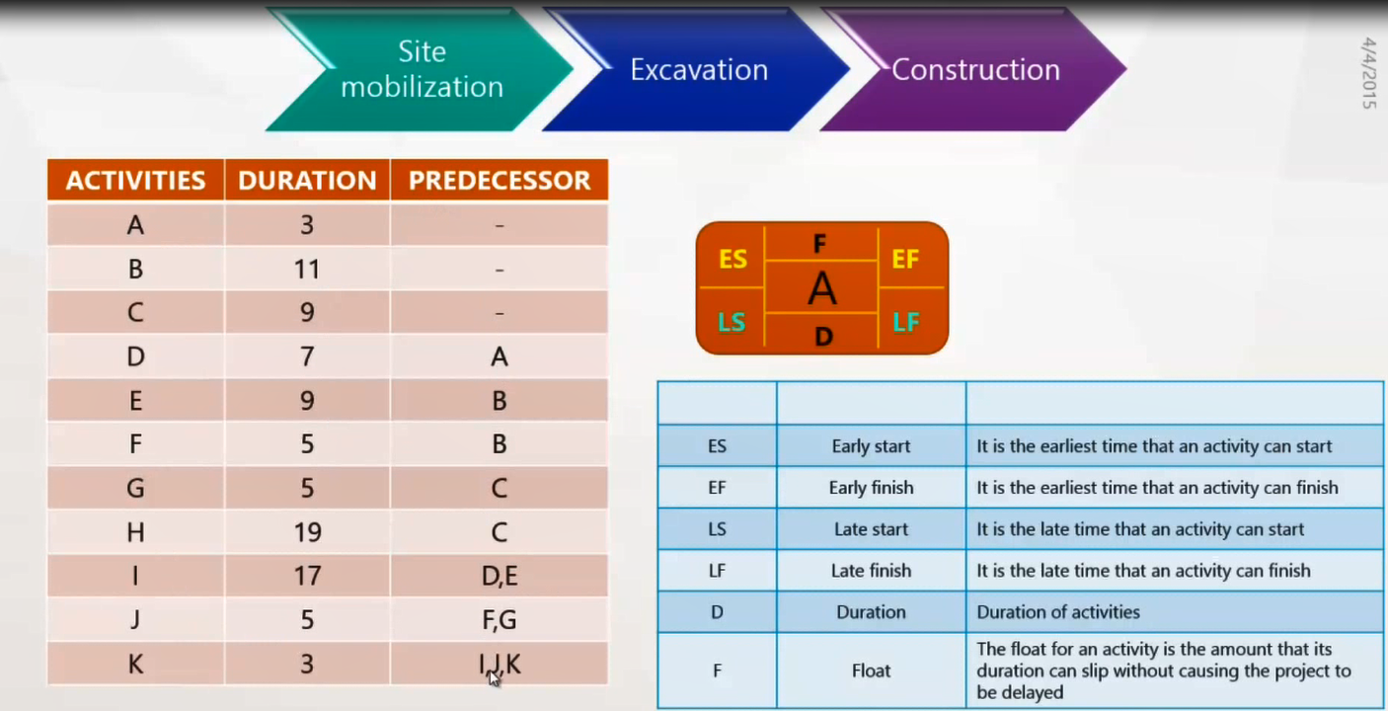
CRITICAL PATH METHOD

Slide 48
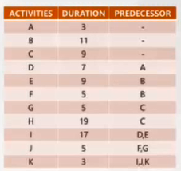
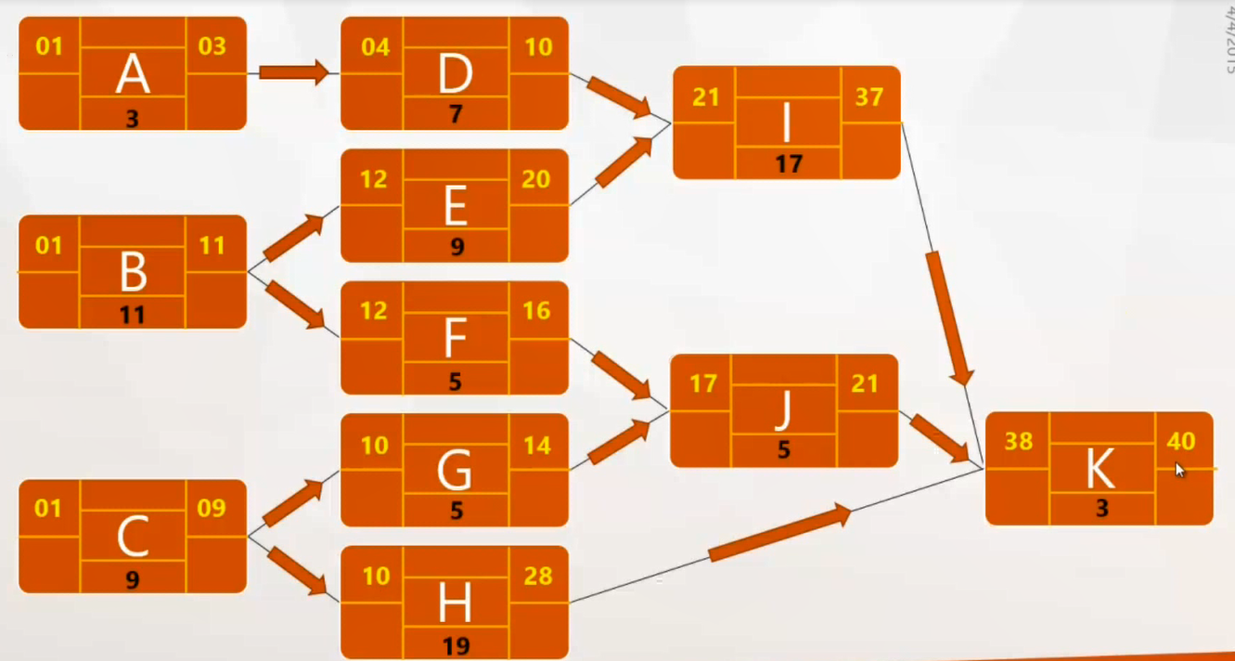
CPM - Forward Pass
EF+1 = ES of next activity
Take greater value + 1
ES+D-1=EF

Slide 49
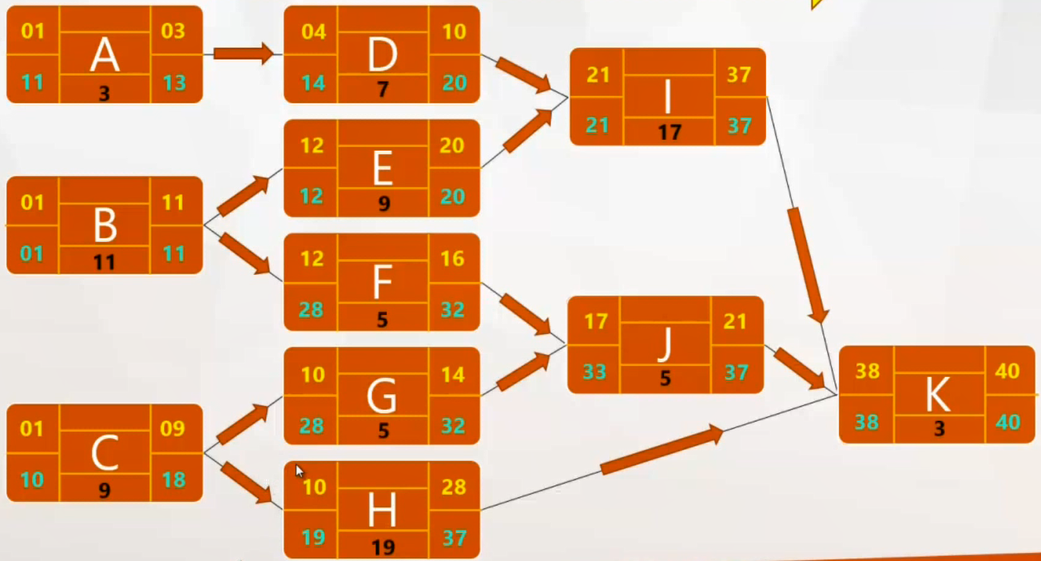
CPM – Back word Pass
LF – D + 1 = LS
LS-1 = LF of next activity
Take lesser value - 1

Slide 50
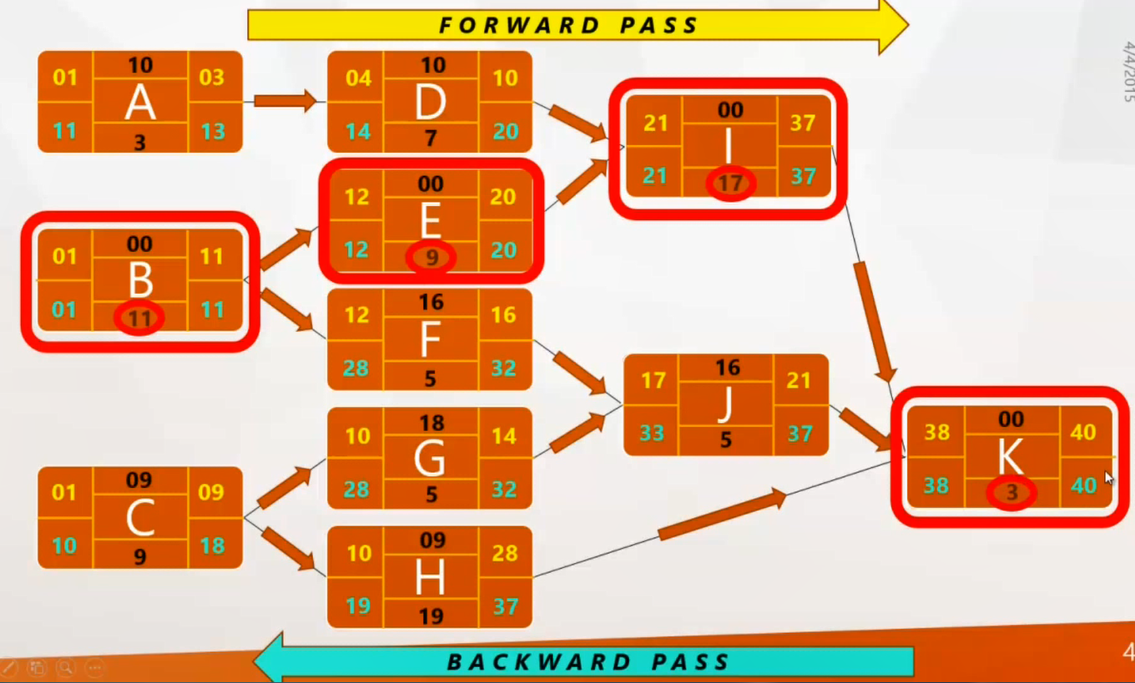
CPM – Float and Critical Path
LS – ES = Float
Critical Path
B -> E -> I -> K
11+9+17+3 = 40
Float on CP = 0
Delaying activities on Critical path will delay the project

Slide 51
Critical path
Note the path through network with zero floats
Critical path: any delay in an activity on this path will delay whole project
Can there be more than one critical path?
Can there be no critical path?
Sub-critical paths
Notes:
Yes, there could be more than one critical path if the two longest paths through the network were of equal length.
Where the target completion date for the project was imposed rather than calculated from the earliest finish dates, it might be later that the earliest finish date. In this case there would be no chains of activities with zero floats
The durations of activities are only estimates to start with. As the project proceeds, the estimates will be replaced by actual durations which could be different. This could change the sequence of activities identified as the critical path. Sub-critical paths are chains of activities, not on the planned critical path, but which have small floats and which could easily become the critical path as the project develops.

Slide 52
Free and interfering float
A
7w
0
B can be up to 3 days late
and not affect any
other activity = free float
7
2
9
2
B
4w
D
1w
E
2w
0
4
7
8
10
12
5
9
9
10
10
12
5
2
0
C
10w
0
10
0
10
B can be a further 2 days late – affects
D but not the project end date =
interfering float
0
Notes:
Total float = LF – ES – duration (or LS-ES or LF-EF)
Free float = ES for following activity less EF for the current
Interfering float = total float – free float

Slide 53
Drawing up a PERT diagram
No looping back is allowed – deal with iterations by hiding them within single activities
milestones – ‘activities’, such as the start and end of the project, which indicate transition points. They have zero duration.

Slide 54
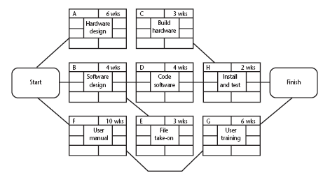
Example of an activity network
Notes:
Work out the earliest start and end dates for each activity

Slide 55
Complete the table
Notes:
Activity ES duration EF LS LF Float
A 0 6 6 2 8 2
B 0 4 4 3 7 3
C 6 3 9 8 11 2
D 4 4 8 7 11 3
E 4 3 7 7 10 3
F 0 10 10 0 10 0
G 10 3 14 10 13 0
H 9 2 11 11 13 2

